Slide 1

Learning Objective
Review reading and interpreting graphs
Enter quietly, please be ready with the following on your desk:
Whiteboard
Whiteboard marker
Exercise Book
Pencil, pen, ruler and red pen
Diary
Calculator
Textbook
Device – charged or borrowed from Library before maths

Slide 2

Learning Objective
Read and interpret information from graphs
Success Criteria
At the end of the lesson, I will be able to:
Read information from graphs

Slide 3
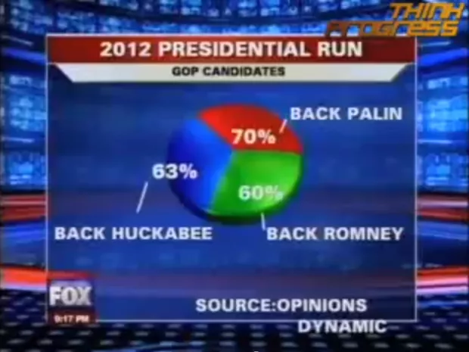
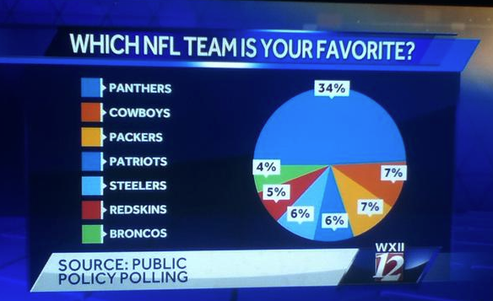
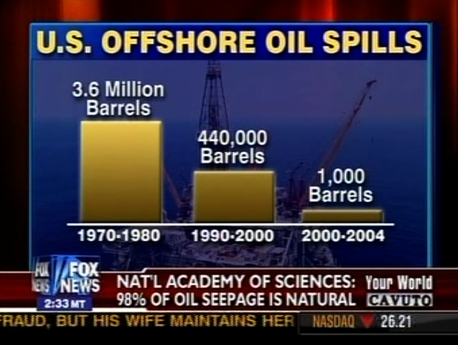
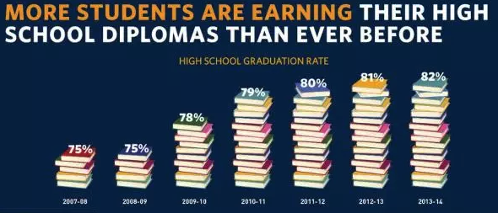
Activating Prior Knowledge
Graphs and charts are easy ways to visually represent data.
We see them every day, especially in the news.
193%

Slide 4
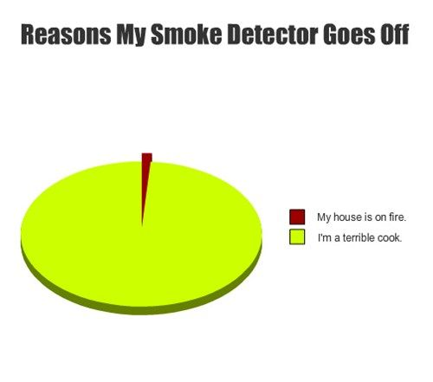
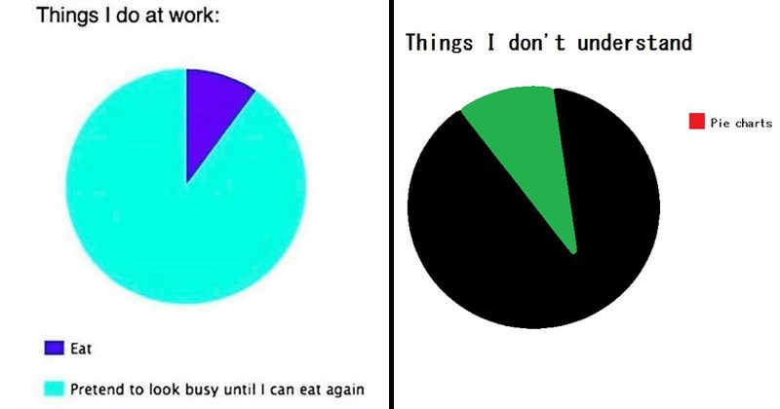
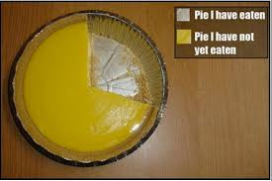


Activating Prior Knowledge
Divided Bar Graphs and Sector Graphs
These two types of graphs are used to show a whole divided into parts so you can easily compare.
 | Favourite ice-cream flavour
Chocolate | 12
Vanilla | 4
Strawberry | 7
Banana | 1

Slide 5
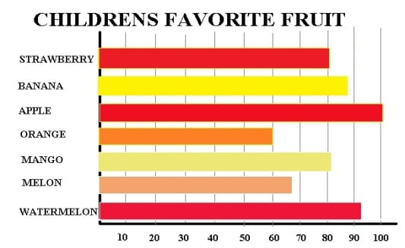
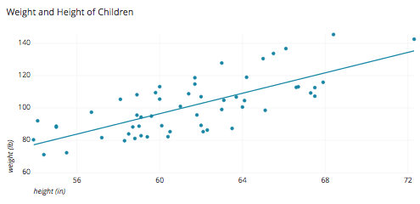
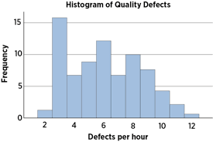
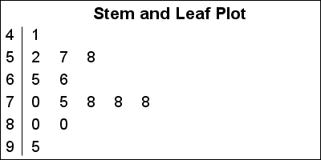
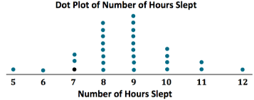
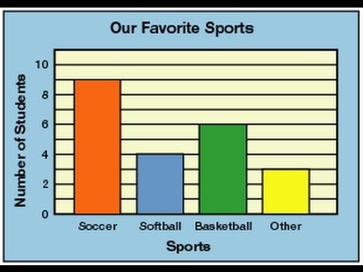
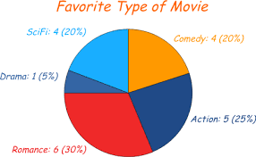
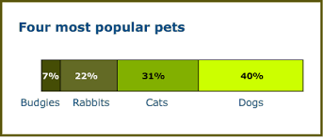
Activating Prior Knowledge
What graphs have you used so far in school?
Bar Graph
Scatter Plot
Histogram
Column Graph
Sector Graph
Divided Bar Graph

Slide 6
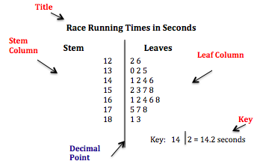
Activating Prior Knowledge
Stem-and-Leaf Plots
Another way to represent data is to use a stem-and-leaf plot.
A stem-and-leaf plot is a good way to represent a large amount of numerical data. It also shows individual data points.
The numbers of ‘leaves’ represents the number data points.
When ordered correctly it can also be used to quickly interpret range and mode.

Slide 7
Activating Prior Knowledge
Number of hours spent on the phone each month.
59 88 72 63 77 78 54 90 51 95 83 74
Step 1: Draw a vertical line. Label the left side ‘stem’ and the right side ‘leaf’.
Number of Hours
Step 2: Cover the digit on the right. Looking at the digit/s on the left, place the numbers in ascending order in the stem column.
Stem
Leaf
5
1
4
9
6
3
Step 3: Now look at the ones column of your data. Place these in the leaf column in line with the appropriate stem.
7
2
4
7
8
8
3
8
Step 4: Label your dot plot.
9
0
5
Step 5: Rearrange data if needed and write key.
Key: 9 l 0 = 90

Slide 8
Activating Prior Knowledge
Finding fractions of a whole
Add the number of responses to find the total.
Divide each number by the total to get the fraction of a whole.
Types of Pet | Number recorded | Fraction of a whole | Length of line (mm) | Sector angle (°)
Dog | 78 | $\frac{78}{260}$ = 0.3 | 39 | 108
Cat | 65 | $\frac{65}{260}$ = 0.25 | 32.5 | 90
Bird | 39 | $\frac{39}{260}$ = 0.15 | 19.5 | 54
Rabbit | 26 | $\frac{26}{260}$ = 0.10 | 13 | 36
Other | 52 | $\frac{52}{260}$ = 0.20 | 26 | 72
Total | 260 | 1 | 130 | 360

Slide 9
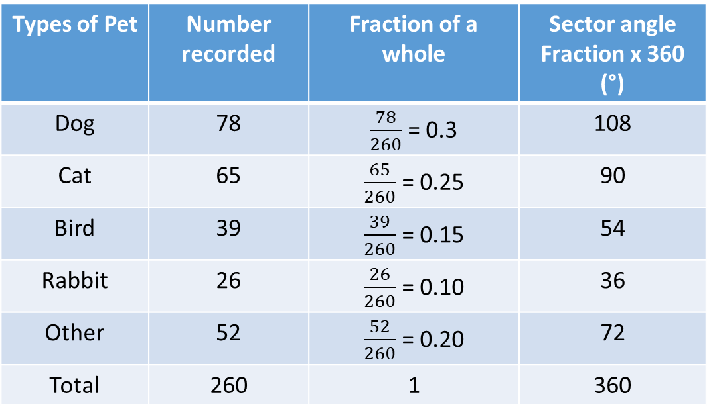
Activating Prior Knowledge
Sector Graphs
Multiply the fraction for each type by 360°
Use a protractor to accurately measure and mark out graph
Types of Pet | Number recorded | Fraction of a whole | Sector angle Fraction x 360 (°)
Dog | 78 | $\frac{78}{260}$ = 0.3 | 108
Cat | 65 | $\frac{65}{260}$ = 0.25 | 90
Bird | 39 | $\frac{39}{260}$ = 0.15 | 54
Rabbit | 26 | $\frac{26}{260}$ = 0.10 | 36
Other | 52 | $\frac{52}{260}$ = 0.20 | 72
Total | 260 | 1 | 360

Slide 10
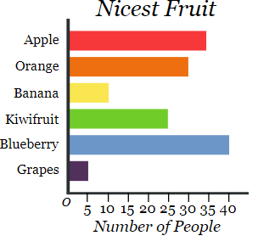
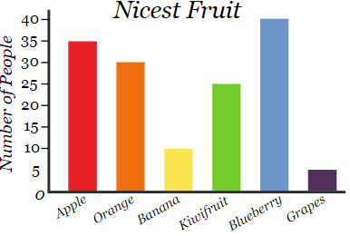
Activating Prior Knowledge
Two commonly used graphs are the column and bar graph.
People often mix up the two as they are very similar.
Column graphs have vertical columns.
Bar graphs have horizontal bars.

Slide 11

Activating Prior Knowledge
CFU 1
Column Graphs
What type of data is this?
Favourite Chocolate Bar
10
Must Have:
Title.
x-axis scale.
y-axis scale.
x-axis label.
y-axis label.
Gaps between columns.
9
Favourite Chocolate Bar | Freq
Mars
Bounty
Snickers
Picnic
Milky Way
Flake
Crunchy
8
7
6
Number of Students
5
4
3
2
1
Mars
Bounty
Snickers
Picnic
Milky Way
Flake
Crunchy
Chocolate Bar Brand

Slide 12
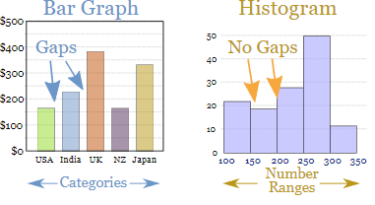
Activating Prior Knowledge
Histograms
One graph you might have seen in science is called a histogram.
Histograms are used to graph grouped continuous data.
WRONG!
This is a column graph.
Column and Bar graphs have gaps. Histograms do not.

Slide 13
Activating Prior Knowledge
Histograms
Time to run 1 km (mins)
10
Must Have:
Title.
x-axis scale.
y-axis scale.
x-axis label.
y-axis label.
No gaps between columns.
9
8
Time to Run 1 km (min) | Freq
4 - <6 | 2
6 - <8 | 5
8 - <10 | 9
10 - <12 | 8
12 - <14 | 4
7
6
Number of people (Frequency)
5
4
3
2
1
0
2
4
6
8
10
12
14
Time (mins)

Slide 14
Activating Prior Knowledge
Histograms
Time spent playing games in a day (min) | Freq
0 - <20 | 5
20 - <40 | 3
40 - <60 | 7
60 - <80 | 2
80 - <100 | 5
Must Have:
Title.
x-axis scale.
y-axis scale.
x-axis label.
y-axis label.
No gaps between columns.

Slide 15
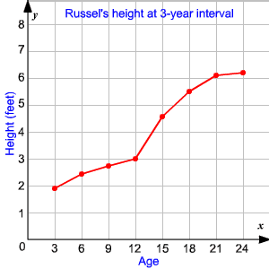
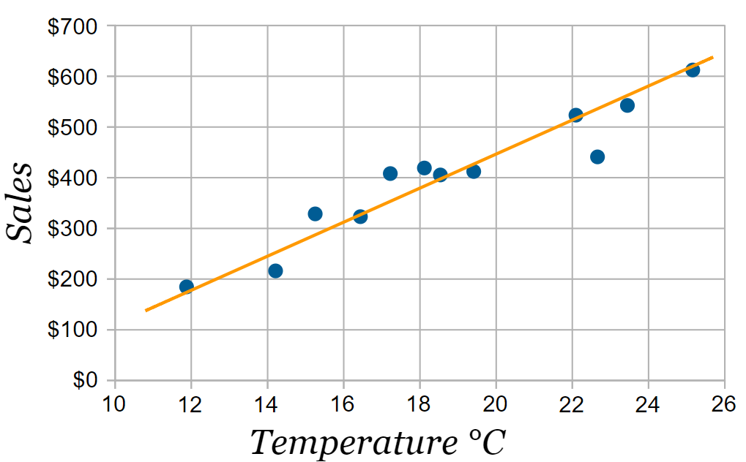
Activating Prior Knowledge
Line graphs are similar to the scatter plots that you draw in science.
Both types of graph are a good way to show patterns or trends in bivariate data.
Two variables
Ice-cream Sale Profits at the Beach

Slide 16
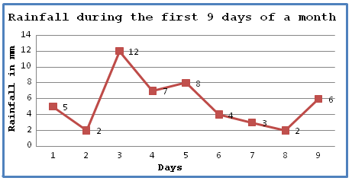
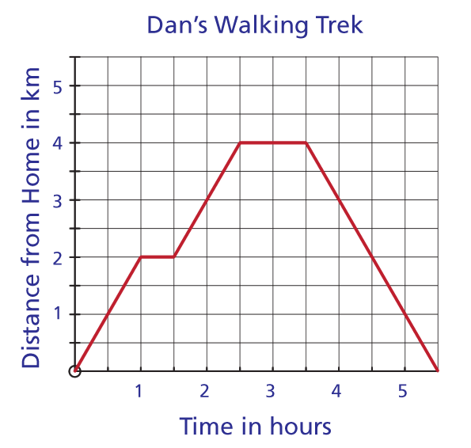
Activating Prior Knowledge
Line graphs have 6 important characteristics.
Must Have:
Title.
Continuous y-axis scale.
Continuous x-axis scale (usually time).
x-axis label.
y-axis label.
Line between points.

Slide 17
Activating Prior Knowledge
Line Graphs
Time (Months) | Temp (○C)
Jan | 38
Feb | 34
Mar | 27
Apr | 26
May | 23
Jun | 19
Jul | 16
Aug | 17
Sep | 20
Oct | 24
Nov | 28
Dec | 34
Average Temperature for each month
40
Must Have:
Title.
Continuous y-axis scale.
Continuous x-axis scale (usually time).
x-axis label.
y-axis label.
Line between points.
36
32
28
24
Temperature (ºC)
20
16
12
8
4
April
May
June
July
January
March
August
October
February
September
November
December
Month

Slide 18
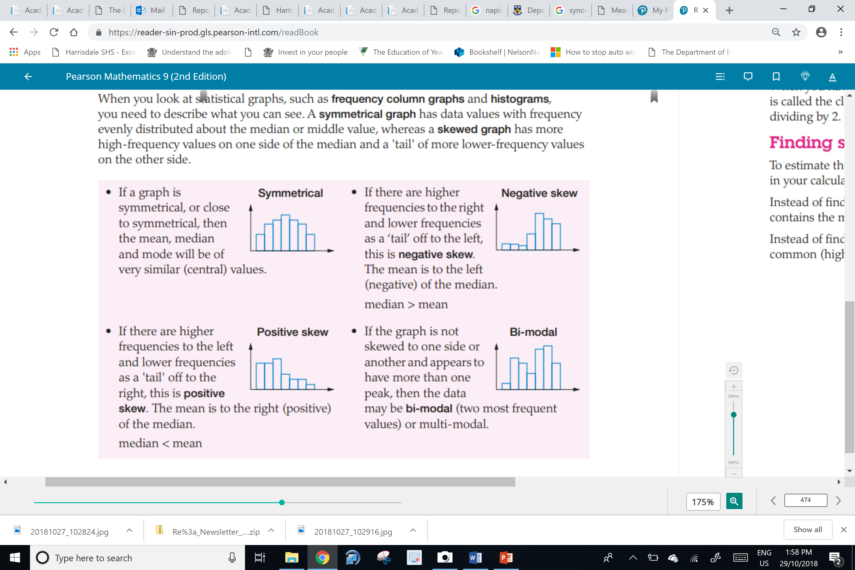
Activating Prior Knowledge
Symmetry (Mean=Median)
When a graph is evenly distributed about the median (middle score)
If the graph is symmetrical, then the mean, mode and median will be similar values

Slide 19
Activating Prior Knowledge
Positive Skew (Mean>Median)
If there is more data on one side, then graph is called skewed
In mathematics, “skewed means empty”
This graph is skewed to the right/empty to the right/positive skew

Slide 20
Activating Prior Knowledge
Negative Skew (Mean<Median)
If there is more data on one side, then graph is called skewed
In mathematics, “skewed means empty”
This graph is skewed to the left/empty to the left/negative skew

Slide 21
Activating Prior Knowledge
Bi-Modal:
A graph is bi-modal (2 modes)/multi-modal(more than 2 modes) if it is
not skewed to the left
not skewed to the right
has more than one peak/mode/ common score
This graph is bi-modal as it has two peaks/modes/common scores

Slide 22
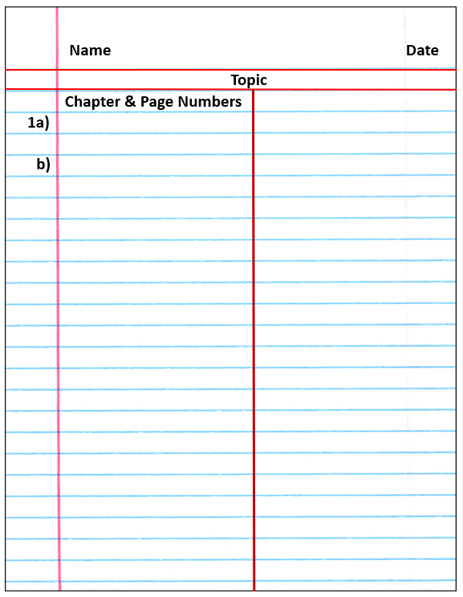
Independent Practice
Mathematics Page Layout
Mathspace Activity

